Slide 1
Vectors
MS864M

Slide 2
Learning Outcomes
Scalar Quantity
Vector Quantity
Addition, Subtraction
Multiplication
Dot product (Scalar)
Cross product (Vector)

Slide 3
Scalars
A physical quantity that is completely described by its magnitude alone is called a scalar.
Examples of scalars are :
Mass
Volume
Work and energy
Time
Density
Temperature

Slide 4
Scalars
Scalars can be added/subtracted using algebraic addition/subtraction.
For example, 2.0 kg + 3.0 kg = 5.0 kg.
A physical quantity is classified as a scalar or a vector depending on whether it makes sense to give it a direction.
Obviously mass, temperature, volume, density, etc. cannot have directions.

Slide 5
Vectors
A physical quantity that is completely described only if both its magnitude and direction are specified is known as a vector.
Examples of vectors are :
Force
Velocity
Acceleration
Displacement
If we ask someone to apply a 100 N force on an object, he cannot act until he is told the direction to apply the force.

Slide 6
Vectors
The direction of a vector may be stated in words or numerically.
For example
the weight of the box is 20 N and its direction is vertically down.
the velocity of the object is 2.0 m/s and its direction is 30º anti-clockwise from the positive x-axis.

Slide 7
Vector notations
A vector can be written as a letter with an arrow on top such as .
It can also be written in boldface, such as A.
The magnitude (size) of a vector is always positive and can be written as , or simply as A.
In our slides, we shall use a letter with an arrow on top to represent a vector and the same letter to indicate its size or magnitude.
E.g. The size of a force is F = 50 N.

Slide 8
Diagrammatic representation of vectors
A vector can be represented as an arrow drawn to scale.
The length of the arrow gives the magnitude and the arrow head gives the direction of the vector.
North
Scale: 1 cm = 10 m/s
2.6 cm
In words : Velocity = 26 m/s in the direction of North East or 45º with respect to East
45º
East

Slide 9
Equality of vectors
Two vectors are equal if they have the same magnitude, are parallel and in the same direction.

Slide 10
Negative vectors
Two vectors are negative of each other if they have the same magnitude, are parallel but in opposite directions.

Slide 11
Scalar multiplication
When a vector is multiplied with a scalar, the resultant vector
has the same or opposite direction as the original vector depending on the sign of the scalar.
is larger or smaller than the original vector depending whether the scalar is greater or less than one.

Slide 12
Scalar multiplication
When a vector is multiplied with a scalar, the resultant vector
has the same or opposite direction as the original vector depending on the sign of the scalar.
is larger or smaller than the original vector depending whether the scalar is greater or less than one.

Slide 13
Resultant of co-planar vectors
Co-planar vectors are vectors which lie on the same 2D plane.
There are 2 methods of finding the resultant when adding or subtracting co-planar vectors, viz :
By drawing
By resolution of vectors

Slide 14
Triangle rule - adding two vectors
The resultant of adding two vectors is obtained by
placing the tail of the second vector at the head of the first vector
drawing a line joining the tail of the first vector to the head of the second vector. Animation
⇒

Slide 15
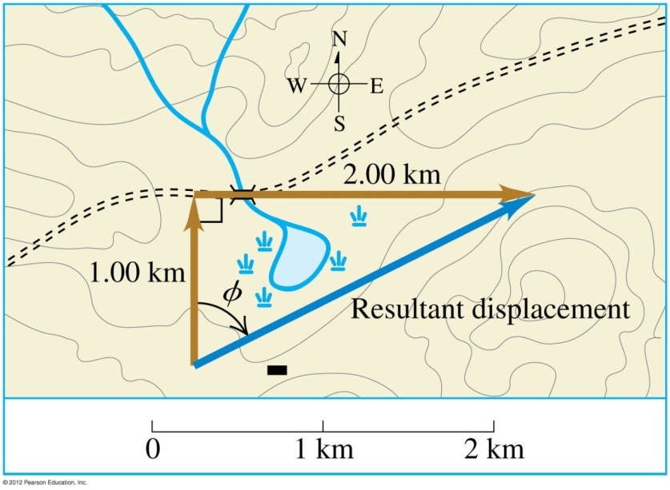
Example 1
A cross-country skier skis 1.00 km north and then 2.00 km east on a horizontal snow field. How far and in what direction is she from the starting point, i.e. what is her final displacement?
The resultant (final) displacement is 2.24 km and its direction is 63.4º wrt N or 63.4º north of east.

Slide 16
Polygon rule for 3 or more vectors
This is an extension of the triangle rule.
It is used for adding more than two vectors by drawing.
The resultant is the line joining the beginning of the first vector to the end of the last vector after putting all the vectors touching heads to tails.
⇒

Slide 17
Example 2
Add the force vectors and comment on your result.
⇒

Slide 18
Triangle rule – Subtracting two vectors
It is easier to treat vector subtraction as vector addition by reversing the vector to be subtracted.
For example, to find , we write it as

Slide 19
Example 3
An object is initially moving east at 11.0 m/s. It then changes direction to move at 11.0 m/s south. What is the change in its velocity?
N
W
E
S
θ

Slide 20
Resolution of vectors
Since vectors can be added to form a resultant, the reverse is also possible.
Any vector can be resolved (break up) into its components.
We usually resolve a vector into mutually perpendicular components. Animation
In a 2D rectangular coordinate system, the components are usually along the x and y axes.
In a 3D rectangular coordinate system, the components are usually along the x, y and z axes.

Slide 21
Resolving vectors in 2D
A vector in 2D can be resolved into two mutually perpendicular vectors, such that
θ

Slide 22
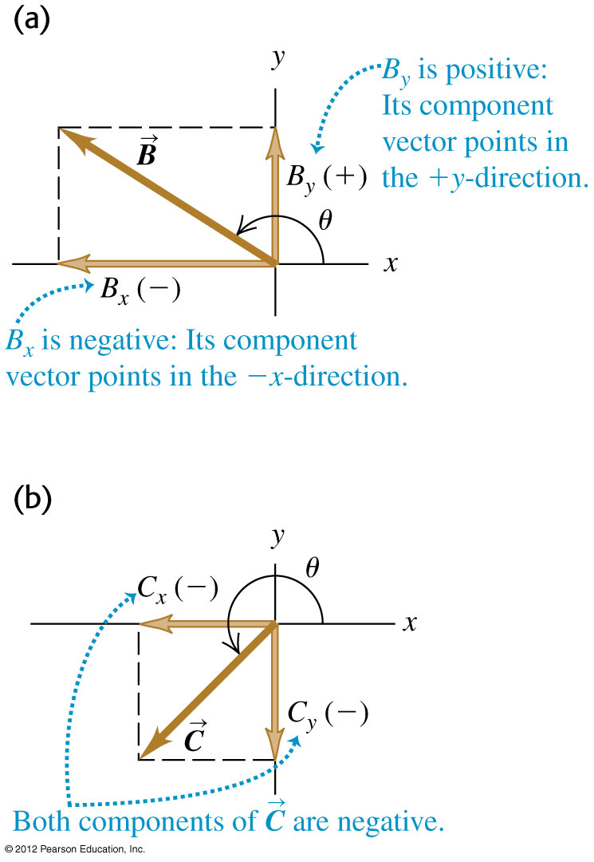
Positive and negative components
The components of a vector can be positive or negative.
In (a), has a positive y component and a negative x component.
In (b), has a negative y component and a negative x component.

Slide 23
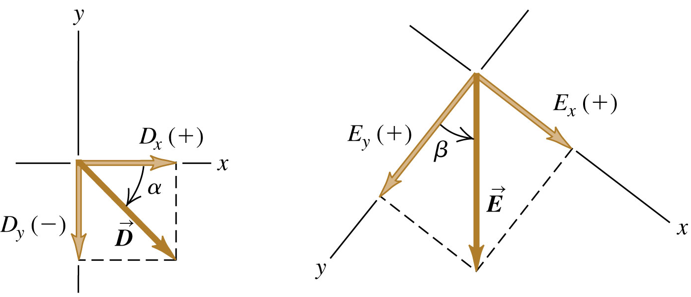
Positive and negative components
What are the x- and y- components of vectors and in the below figures? The magnitude of is 3.00 m and the angle α is 45º. The magnitude of is 4.50 m and the angle β is 37.0º.
Notes:
D_{x} = +2.1 m, D_{y} = −2.1 m, E_{x} = +2.71 m, E_{y} = +3.59 m

Slide 24
Vectors as column matrices
A vector can also be represented as a column matrix where each row consists of its x, y, z components.
The above notation is useful in solving problems.

Slide 25
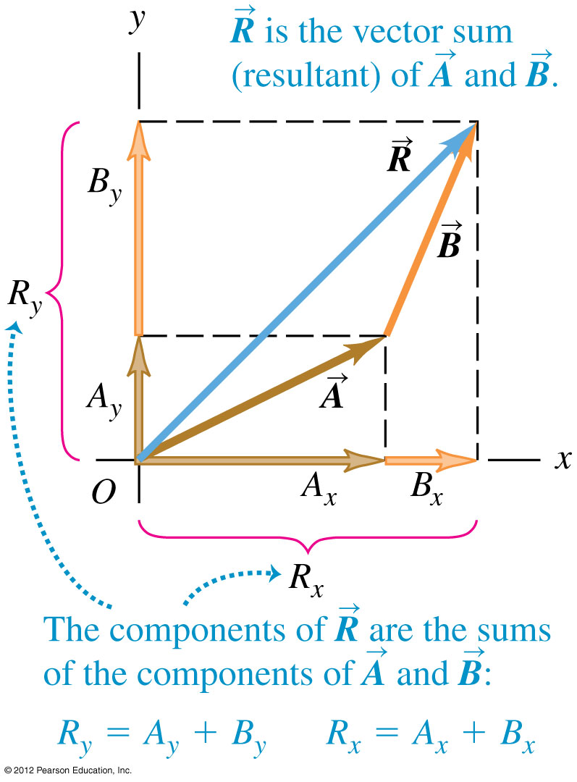
Vectors as column matrices
We can use column matrices to find the sum of two vectors by first adding their x and y components and then adding the resultant components vectorially.
θ

Slide 26
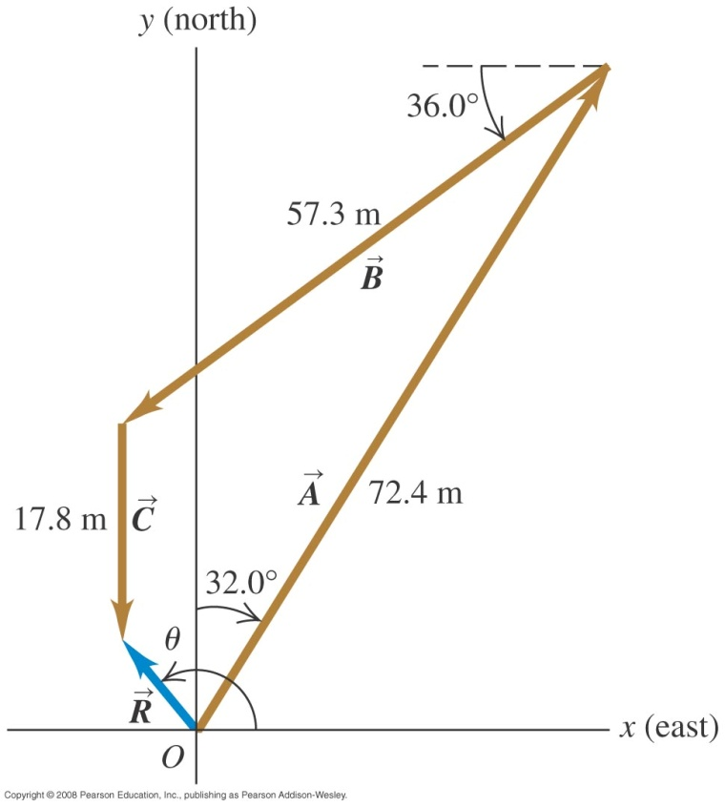
Example 5
An object starts from a point O goes to point A which is described by vector : 72.4 m, 32.0º east of north. It then moves to point B which is described by vector : 57.3 m, 36.0º south of west. Finally it moves to point C which is described by :: 17.8 m due south. Find the resultant displacement vector.
Notes:
R = 12.7 m, θ = −51º. This should be interpreted as 180º – 51º = 129º which is 39º west of north.

Slide 27
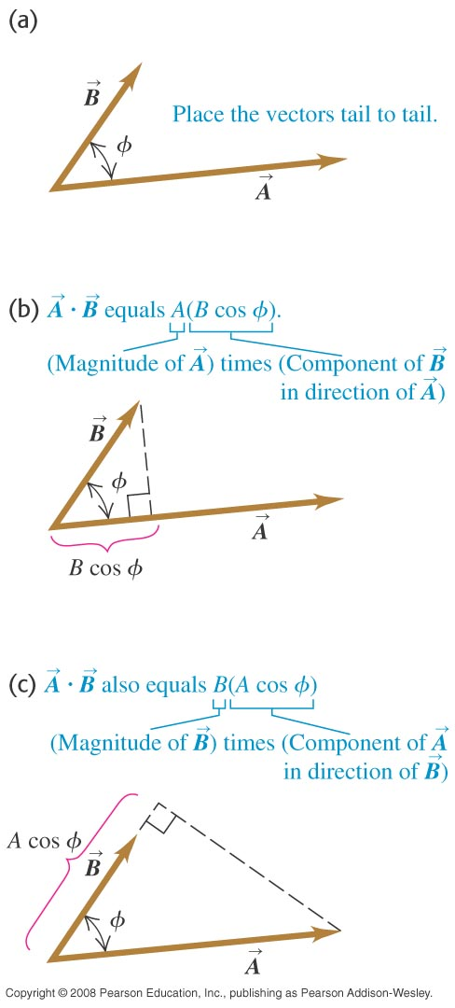
Dot (scalar) product of two vectors
The dot product between two vectors is defined as
where φ is the angle between
The result C is a scalar.
Note that A and B are positive quantities.
Since ,

Slide 28
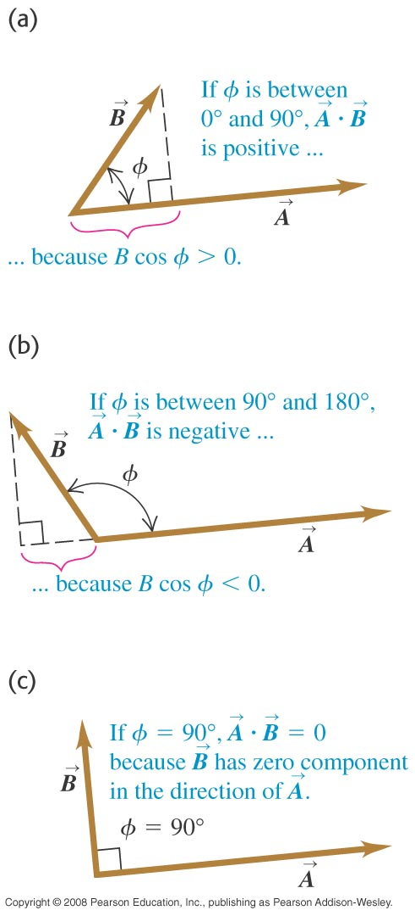
Dot (scalar) product
The dot product can be positive, negative or zero, depending on the angle φ between the two vectors.
The dot product of two perpendicular vectors is zero since cos 90º = 0.

Slide 29
Application of dot product
If a constant force is applied on an object such that it undergoes a displacement , the work done, which is a scalar, is given by
Work is maximum when the force is parallel to the displacement and work is zero when the force is perpendicular to the displacement.
Work can be positive or negative depending on φ .
φ
φ

Slide 30
Resolving vectors in 3D
A vector in 3D can be resolved into three mutually perpendicular components as follow :
z
γ
y
x
θ

Slide 31
Cross (vector) product
The cross product of two vectors is defined by
The result is a third vector .
The magnitude of is given by
The direction of is perpendicular to both and can be obtained using the right hand grip rule.
φ
y
x

Slide 32
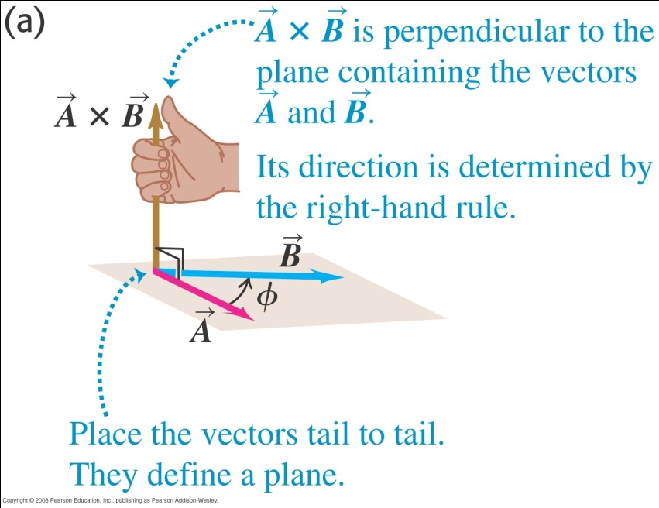
Right hand grip rule
Imagine rotates about a perpendicular line until it is aligned with .
Curl the fingers of your right hand around the perpendicular line so that the finger tips point in the direction of the rotation.
The thumb points in the direction of .

Slide 33
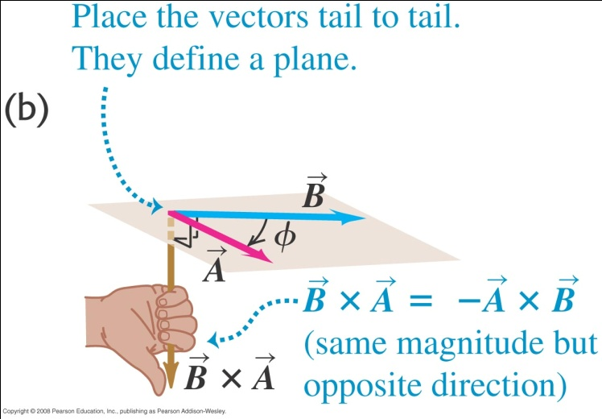
Right hand grip rule
If is rotated about a perpendicular line until it is aligned with , the thumb points in the direction of .
In other words .

Slide 34
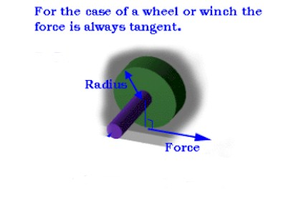
Application of cross product
The vector is known as torque where is the radius vector and is the force vector.
The magnitude of is known as the moment (turning effect) of the force.
The direction of is given by the right hand grip rule. Animation
Notes:
Turning force depends on r and the perpendicular force at r.

Slide 35
Unit vector
A unit vector has magnitude 1.
It is used to indicate direction of a vector.
Unit vectors are denoted with small letters and a hat on top.
E.g. the unit vector pointing in the same direction as the vector is .
It follows that .
Three commonly used unit vectors are which point in the x, y and z directions respectively.

Slide 36
Unit vectors in 3D
In 3D, it is usual to use the unit vectors .
These unit vectors have size 1 and point in the direction of positive x, y and z respectively.
Any vector can be written as
z
z
x
y
y
x

Slide 37
Unit vector operations in 3D
Since are perpendicular to each other and of size 1, the following results hold
z
x
y

Slide 38
Vector operations using unit vectors
Addition/Subtraction
Dot product
Cross product
Notes:
Note that i , j & k are all perpendicular to each other. Hence, cross product involve the full magnitude of components of A and B.
To get result in i direction, we sum Ay x Bz and By x Az
To get result in negative j-direction, we sum Ax x Bz and Bx x Az
To get result in k-direction, we sum Ax x Bz and Bx x Az

Slide 39
Example 6
Given the position vectors and , find
a)
b)
in terms of x, y and z components.
Notes:
A + B = 5i – j – 3k
A – B = i – 7j – 11k

Slide 40
Example 7
A force acts on an object and produces a displacement . What is the work done?
Work done is the dot product of the force and displacement.

Slide 41
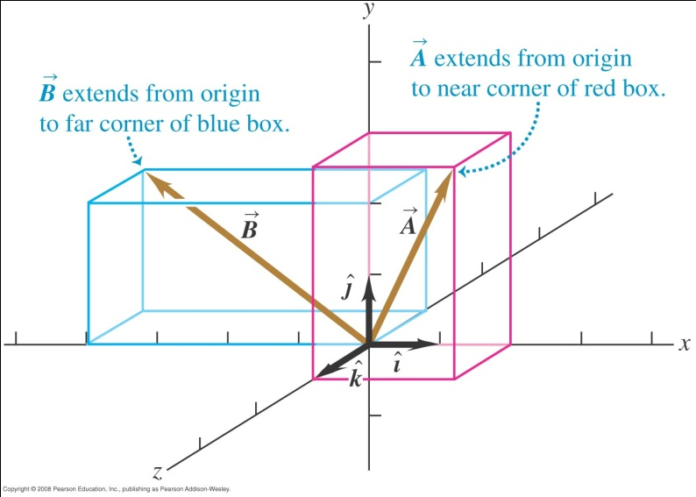
Example 8
Find the angle between the two vectors and
Notes:
Cos @ = -0.175
Basic angle = 80
@ = 180 – 80 = 100
Or @ = 180 + 80 = 260.
The answer @ = 100 is sufficient as the angle between two vectors by default is less than 180.

Slide 42
Example 9
A force acts on an object with position vector . What is the torque about the origin?

Slide 43
Relative velocity
The velocity of a moving body seen by an observer is called relative velocity.
To study relative velocity we need a frame of reference.
A frame of reference is a coordinate system plus a time scale.

Slide 44
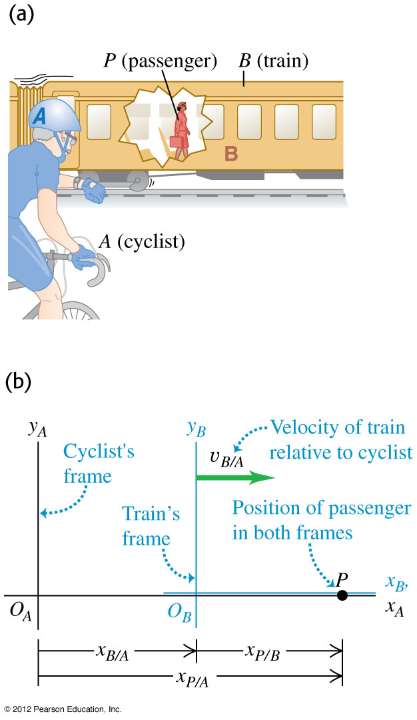
Relative velocity in 1D
From figure (b), the x position of P relative to A is
Imagine the subscripts as a fraction and split it as P/A = P/B × B/A.
The velocity of P relative to A is obtained by differentiation.

Slide 45
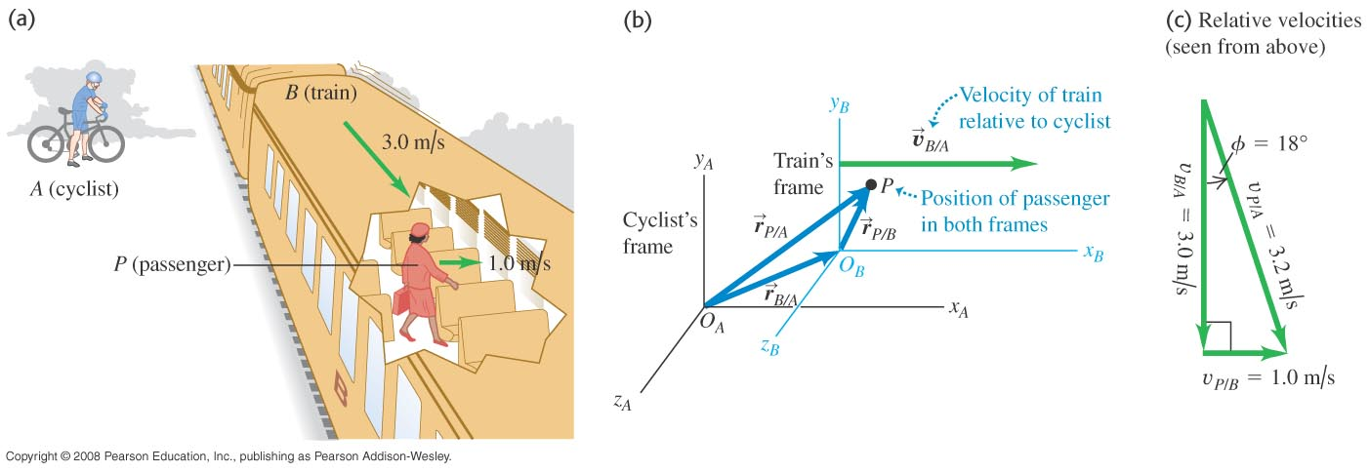
Relative velocity in 2D and 3D
In 2D or 3D, the velocity of P relative to A is obtained by differentiating the position vector

Slide 46
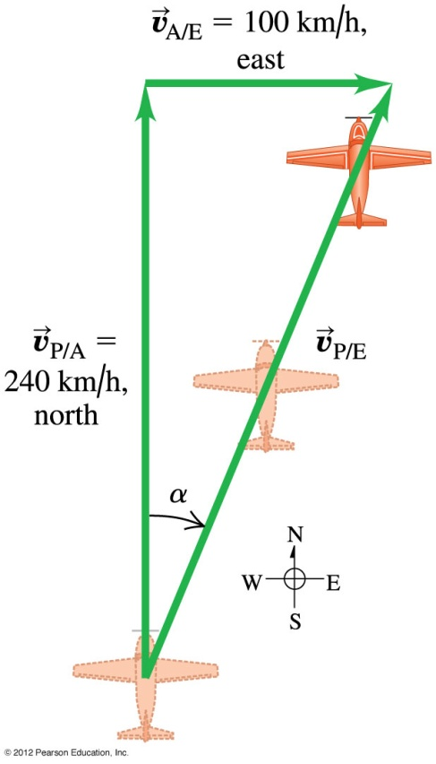
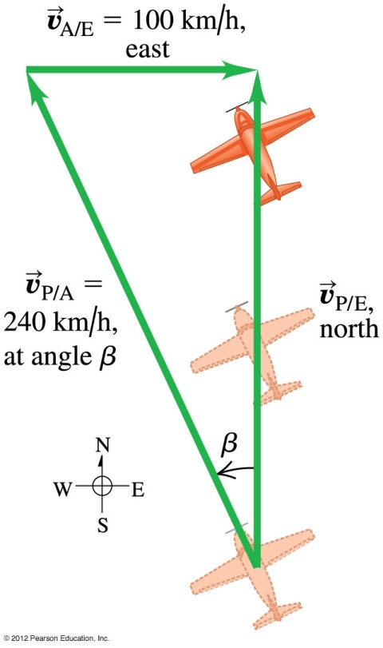
Example 10
a) An air-plane’s compass indicates that it is headed due north and its airspeed indicator shows that it is moving through the air at 240 km/h. If there is a 100-km/h wind from west to east, what is the velocity of the airplane relative to the earth?
b) With the same wind and airspeed, in what direction should the airplane head to travel due north? What will be the velocity of the airplane relative to the earth?
Notes:
a) 260 km/h, 23º east of north b) 218 km/h, 25º west of north

Slide 47
End of chapter

